Slide 1
Today’s U.S. Ethanol Industry: The Value-Added Market for Farmers
Bob Dinneen
Renewable Fuels Association

Slide 2
About the Renewable Fuels Association (RFA)
Trade association representing U.S. ethanol producers
Mission: “Drive expanded production and use of American-made renewable fuels and co-products worldwide”
Founded in 1981
Offices in Washington D.C., St. Louis, Kansas City, and Detroit
Member producers include large bioenergy companies and agribusinesses as well as small farmer-owned co-ops and LLCs
Associate members include vendors, suppliers, supporters, etc.

Slide 3
Today’s Ethanol Industry
212 installed production facilities
199 in operation
13 idle
Installed facilities have “nameplate” capacity to produce 16.1 BG annually
Actual production capacity is likely ≈ 16.4 BG
Actual production in 2016 was 15.41 BG
97% capacity utilization
Feedstock breakdown for installed facilities:
 | Plants | Capacity (MG) | % of Cap.
Corn | 182 | 15,102 | 93.8%
Corn/sorghum/wheat/barley | 14 | 869 | 5.4%
Food/beverage waste | 10 | 30 | 0.2%
Cellulosic biomass | 6 | 92 | 0.6%

Slide 4
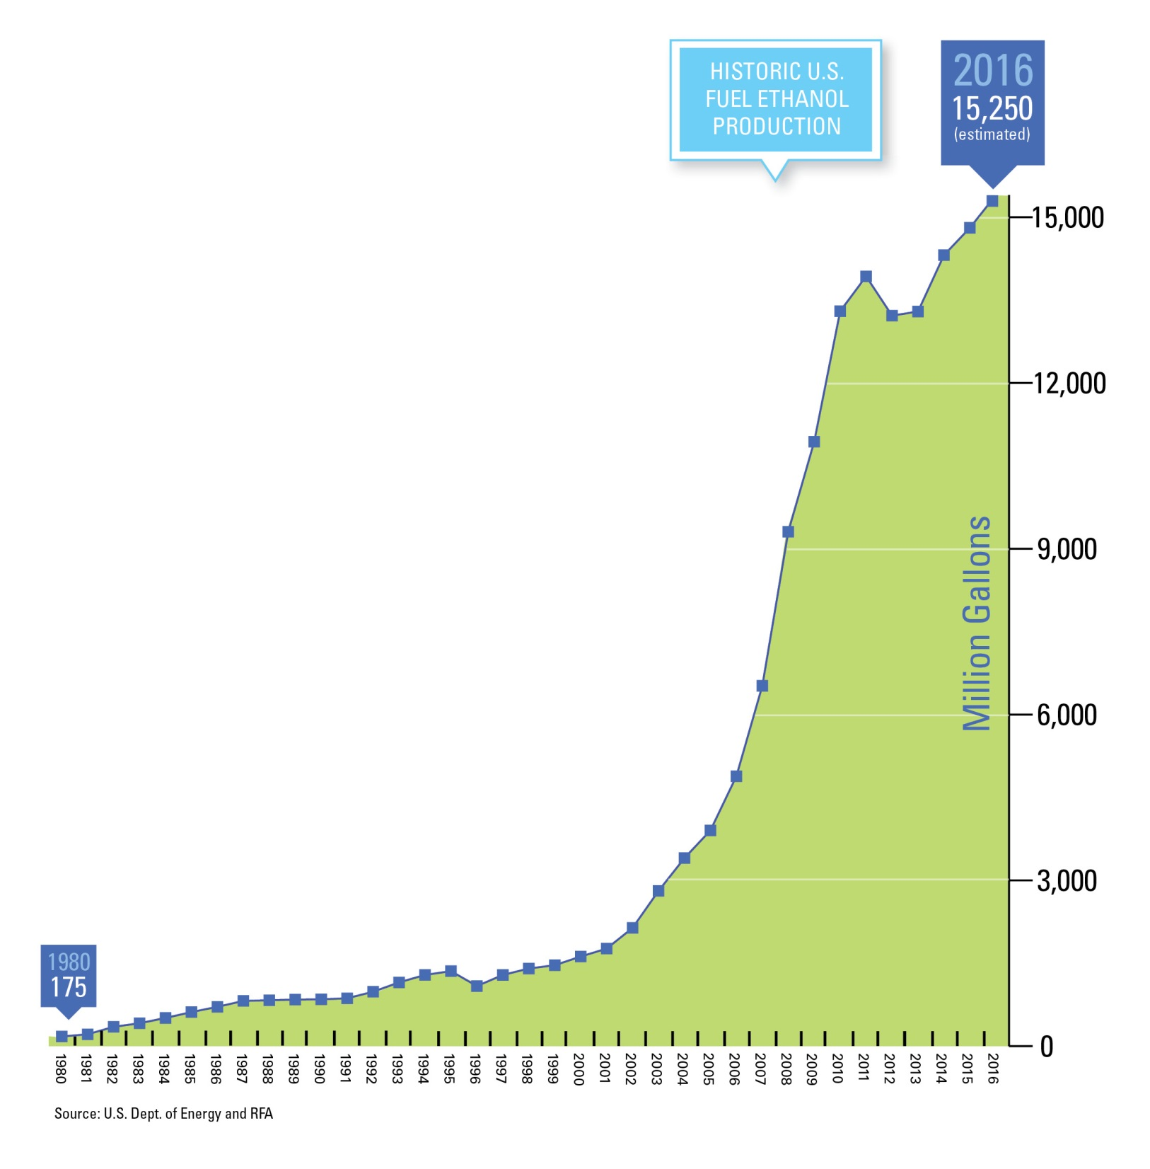

Slide 5
U.S. Ethanol Plants Locations

Slide 6
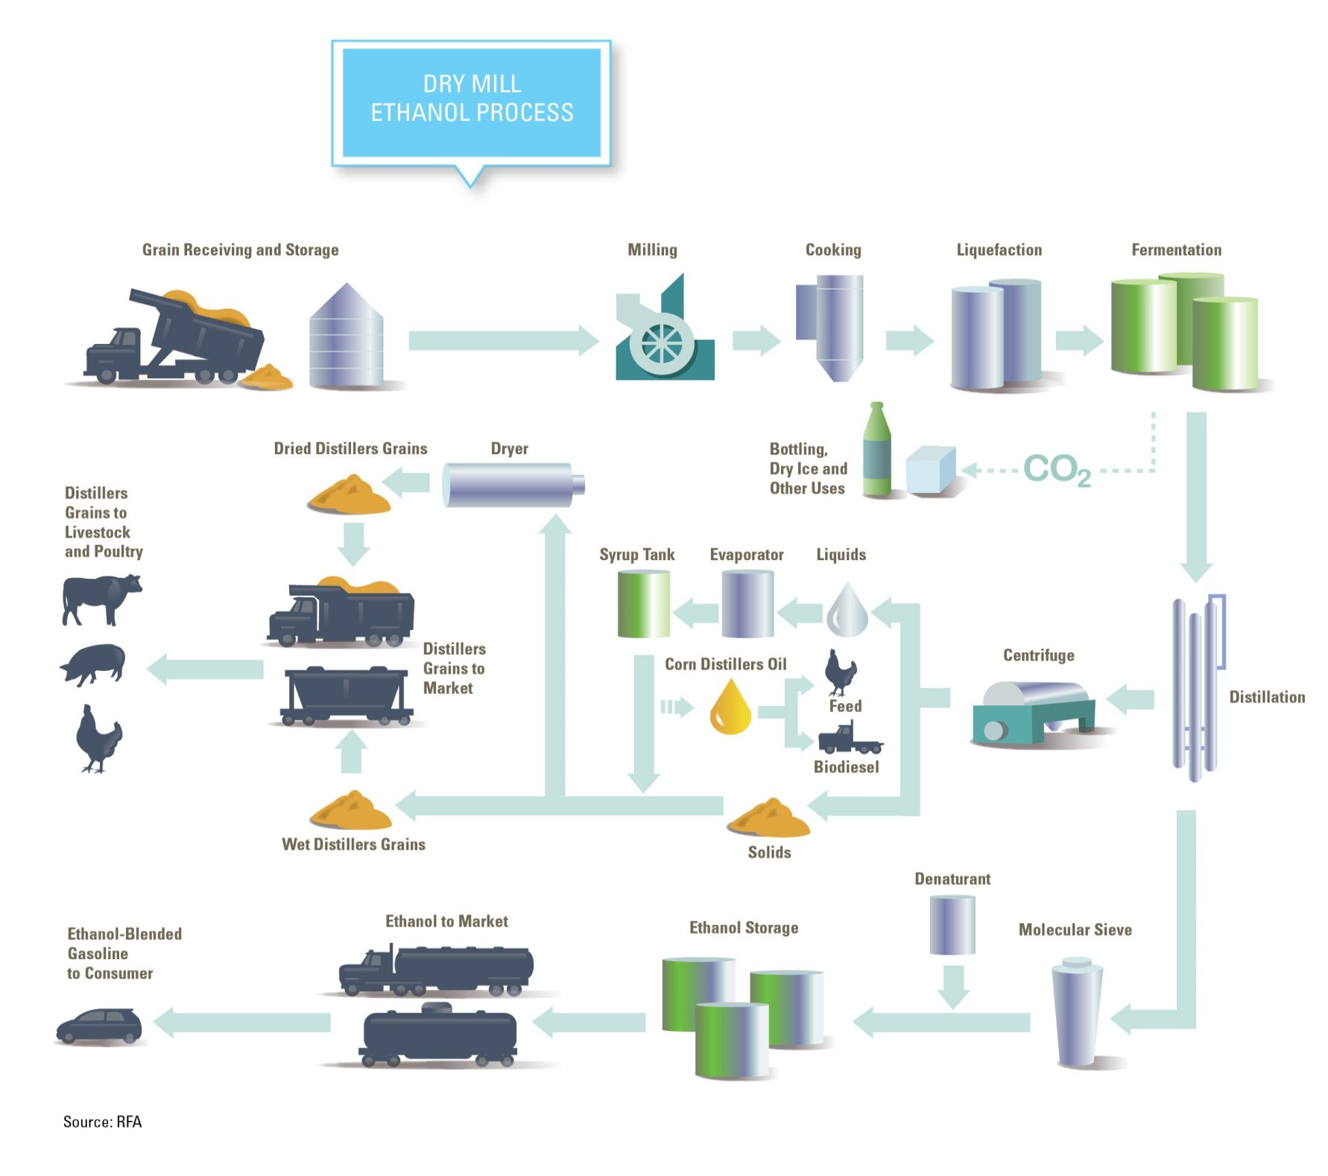

Slide 8
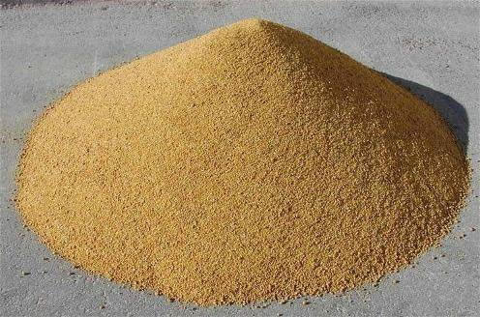
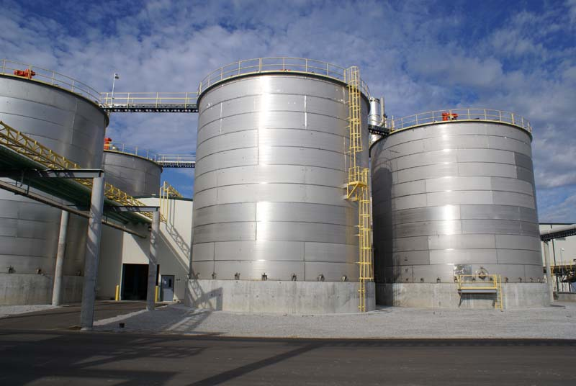
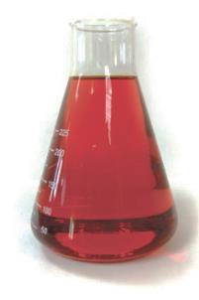
Ethanol Dry Mill Products
290-300 kg CO₂
Moisture 15%
Ash, Other 5%
Fiber 3-4%
Fat 3-4%
275-290 kg Distillers Grains (@10% moisture)
Protein 8-9%
Starch 63-65%
10-15 kg
Corn
Distillers Oil
Ethanol Dry Mill
1,000 kg Corn
400-420 liters Fuel Ethanol
Source: RFA, based on industry data and U.S. Department of Agriculture

Slide 9
On average, 1 bushel of corn (56 pounds) processed by a dry mill ethanol biorefinery produces:
2.85 gallons denatured ethanol
16.5 pounds of distillers grains animal feed (10% moisture)
0.65 pounds of corn distillers oil
17 pounds of biogenic carbon dioxide
Source: RFA and U.S. Dept. of Agriculture

Slide 10
Value of Ethanol Industry Output
Source: RFA calculations based on USDA data

Slide 11
In 2016, the production of 15.25 billion gallons of ethanol and 42 million metric tons of co-products had substantial economic impacts, including:
74,420 direct jobs
264,756 indirect and induced jobs
$42 billion contribution to GDP
$23 billion in household income
$9 billion in tax revenue
U.S. ethanol and co-product exports in 2016 supported:
14,940 direct, indirect, and induced jobs
$3 billion contribution to GDP
$4 billion reduction in the U.S. trade deficit

Slide 12
U.S. gasoline demand set new record in 2016; strong demand expected again in 2017…
Source: EIA
© 2017 Renewable Fuels Association. All Rights Reserved.

Slide 15
How is our ethanol used? Ethanol Supply/Demand 101
2016 Ethanol S/D | Million gals.
Beginning Stocks | 907
Imports | 36
Production | 15,410
TOTAL SUPPLY | 16,353
E10 Blending | 14,059
E15/E85/EFF Blending | 297
Exports | 1,170
TOTAL DEMAND | 15,526
Ending Stocks | 827

Slide 16
Sales of E15 and E85 are expanding as infrastructure buildout continues
E15 and E85 retail infrastructure expansion is accelerating
E85 available at about 3% of U.S. stations
Major retail chains are adopting E15 and E85. Many of their stations are high-volume sites in densely populated areas
E15 and E85 are typically priced competitively to E10
 | July avg. ($/gal.) | vs. E10 (%)
E0 | $2.59 | +17.2%
E10 | $2.21 | --
E15 | $2.13 | -3.6%
E85 | $1.79 | -19.0%
June 2017 avg. retail prices
Source: RFA, E85prices.com, DOE

Slide 17
Ethanol export demand is strong
Source: DOC

Slide 18
Biofuel mandates, smog concerns, octane value driving demand for U.S. ethanol exports…
Top markets for U.S. ethanol exports in 2016
High sugar prices relative to corn in 4Q16 and 1Q17 resulted in significant increase in U.S. ethanol exports to Brazil
Exports to China have ceased in 2017 in response to increased tariff rates
YTD exports to India, Philippines, UAE up in 2017 vs. 2016
Nearly 50 countries have renewable fuel mandates, targets, or goals.
Octane value and oxygen content (smog reduction) also driving export demand.
Still 2+ BG of MTBE blended worldwide.
Canada
(25%)
Rest of World
(5%)
China (17%)
S. Korea (4%)
Mexico
(3%)
UAE
(2%)
Philippines (5%)
Brazil
(26%)
Nigeria
(2%)
India
(8%)
Peru
(4%)
Top markets for U.S. ethanol exports in Jan-Apr 2017
Canada
(20%)
Rest of World
(4%)
Mexico
(2%)
S. Korea (2%)
Nigeria (2%)
UAE
(5%)
India
(15%)
Philippines (7%)
Peru
(3%)
Brazil
(40%)
Source: DOC

Slide 19
U.S. ethanol imports have been sparse
Source: EIA
© 2017 Renewable Fuels Association. All Rights Reserved.

Slide 20
High sugar prices mean sugarcane has not been competitive with corn as ethanol feedstock…
1/3/17
3/1/17
OCT17 sugar vs. SEP17 corn
5/1/17
Favors Corn
6/8/17
Favors Sugar
6/1/17
Source: RFA, CME Group, ICE
© 2017 Renewable Fuels Association. All Rights Reserved.

Slide 21
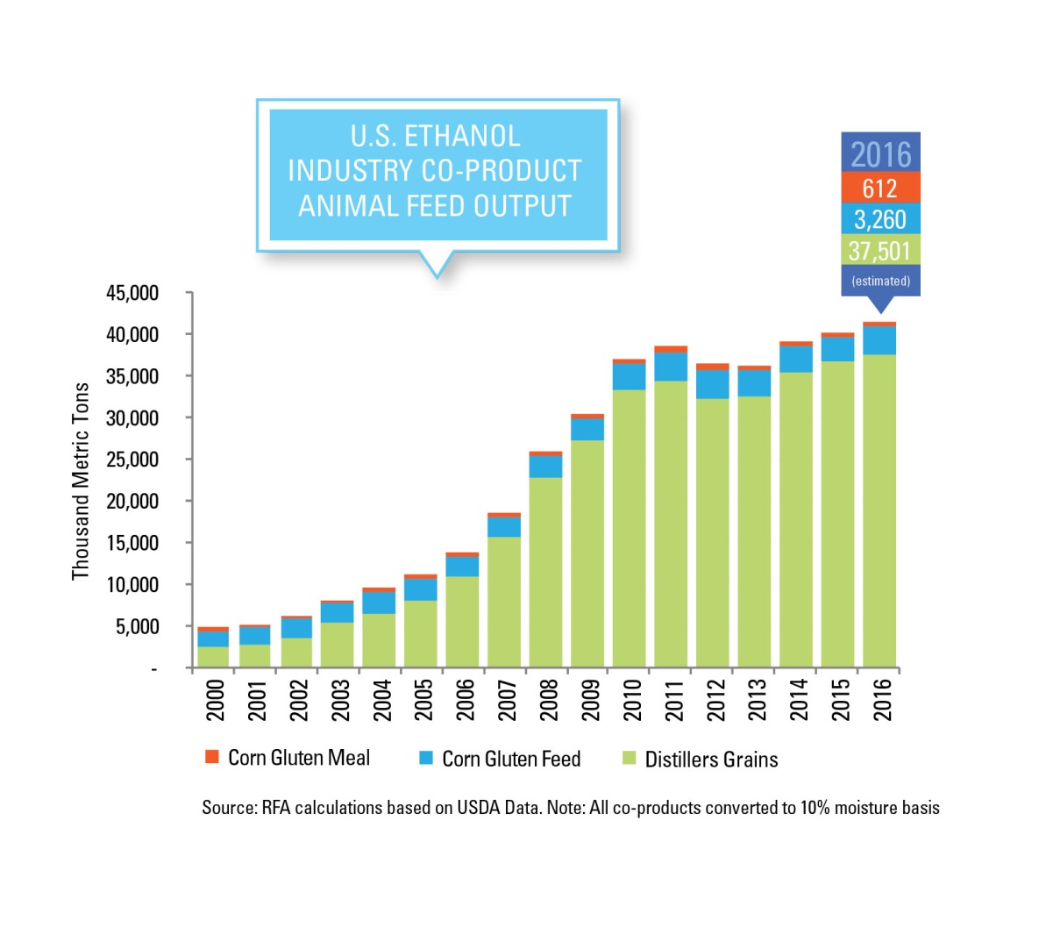

Slide 22
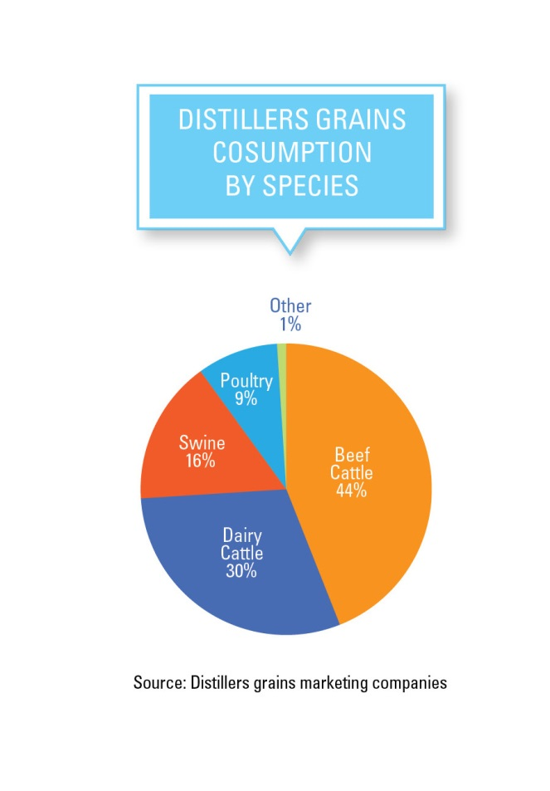

Slide 23
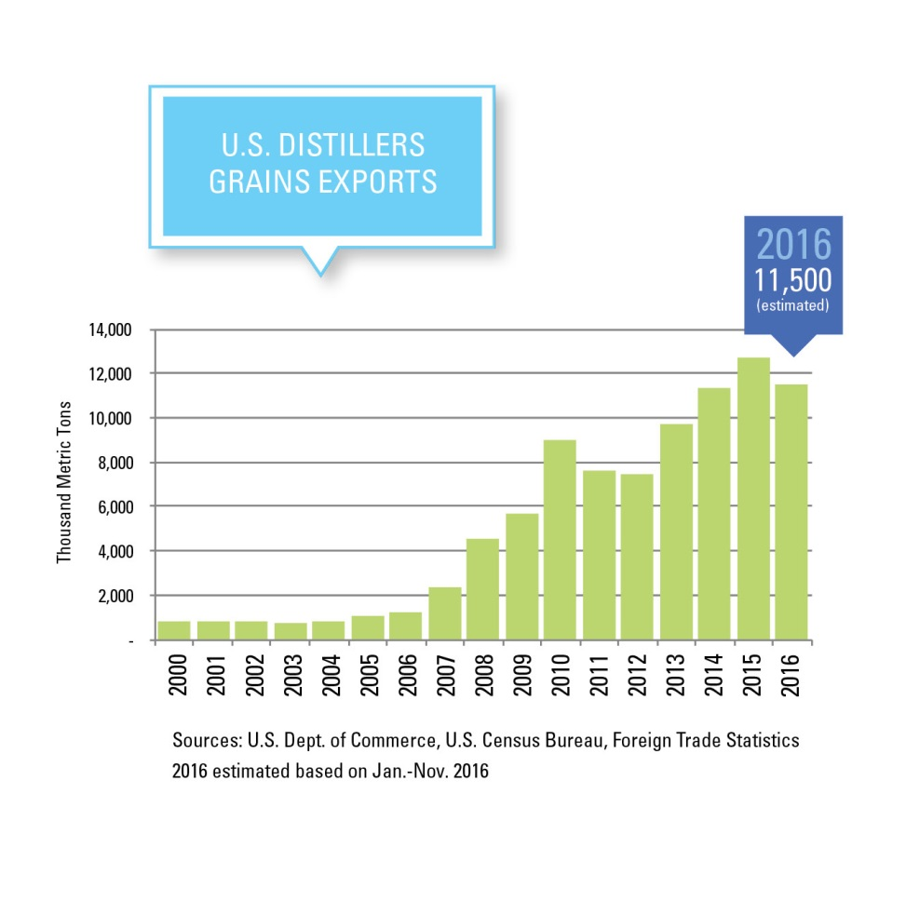

Slide 24
Ethanol’s Future Looks Bright But Threats Remain
Oil Company Attacks on RFS/Ethanol Persist
PA Gov RFS Waiver Request
Inconsistent Policy Signals Chills Investment
Recent Proposals From EPA
RVP
Increasingly Protectionist Trade Actions Across the Globe
Climate Change Agenda Fading Domestically

Slide 25
Thank You
Renewable Fuels Association
www.ethanolrfa.org
(202) 289-3835

Slide 26
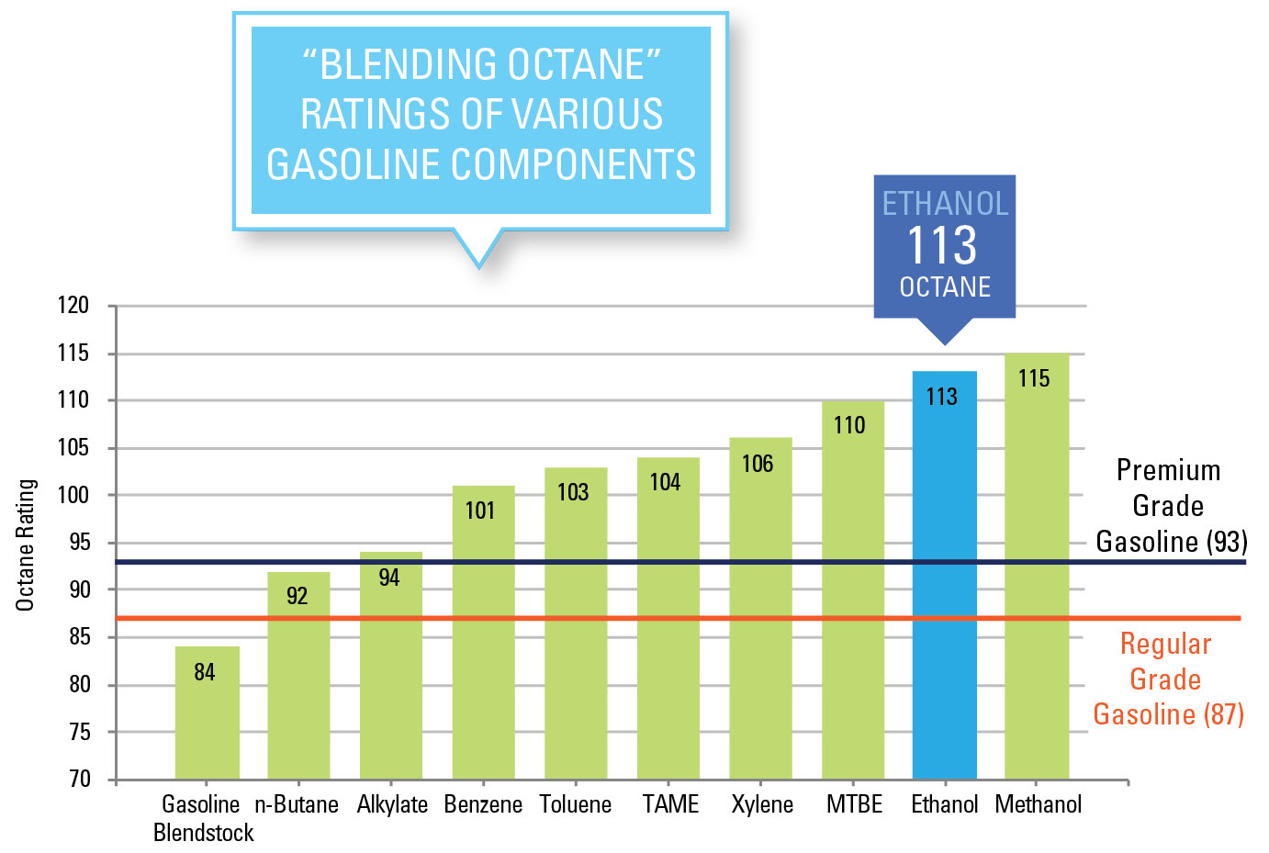
Ethanol is the lowest-cost and cleanest source of octane for gasoline
Not approved by OEMs
Banned in 26 states
Highly toxic. Limited to 1% of blend
High volatility
© 2017 Renewable Fuels Association. All Rights Reserved.

Slide 27
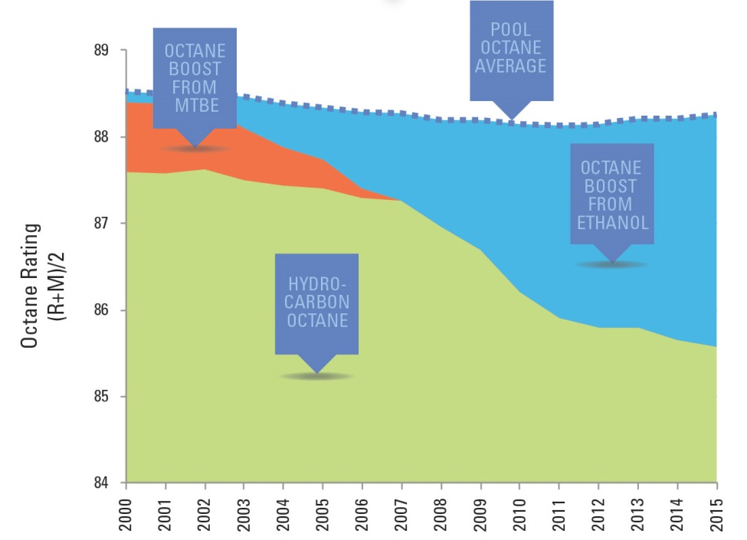
Ethanol’s contribution to U.S. gasoline pool octane, 2000-2015

Slide 28
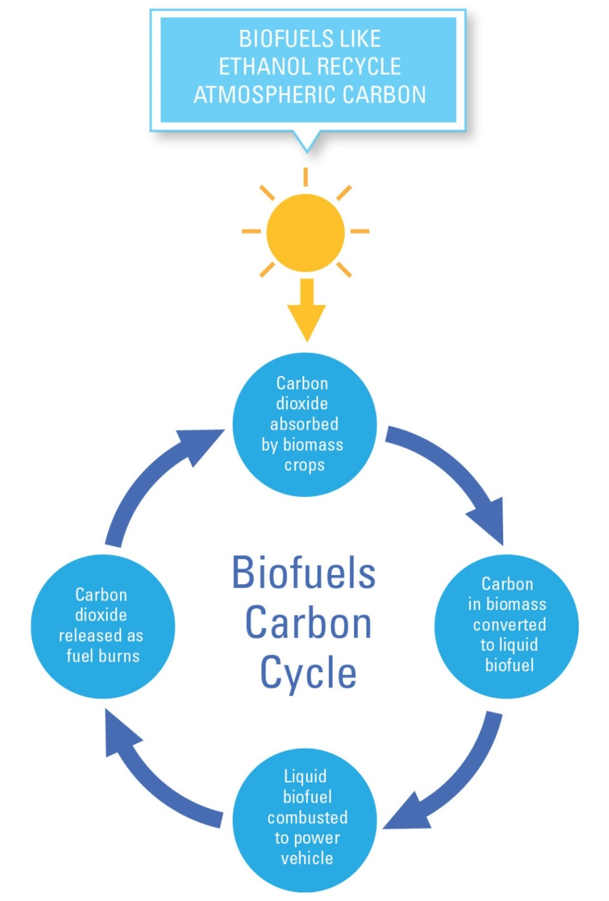
Ethanol reduces greenhouse gas (GHG) emissions
On average, corn ethanol reduces GHG emissions by 43% compared to U.S. gasoline (USDA) including land use change penalties
Some U.S. corn ethanol reduces GHG emissions by 50-60% (EPA, CARB, DOE)
Some U.S. corn ethanol reduces GHG emissions by more than 50% compared to EU gasoline under RED (EC)
Some U.S. corn ethanol meets Japan’s 50% GHG reduction threshold and sustainability criteria

Slide 29
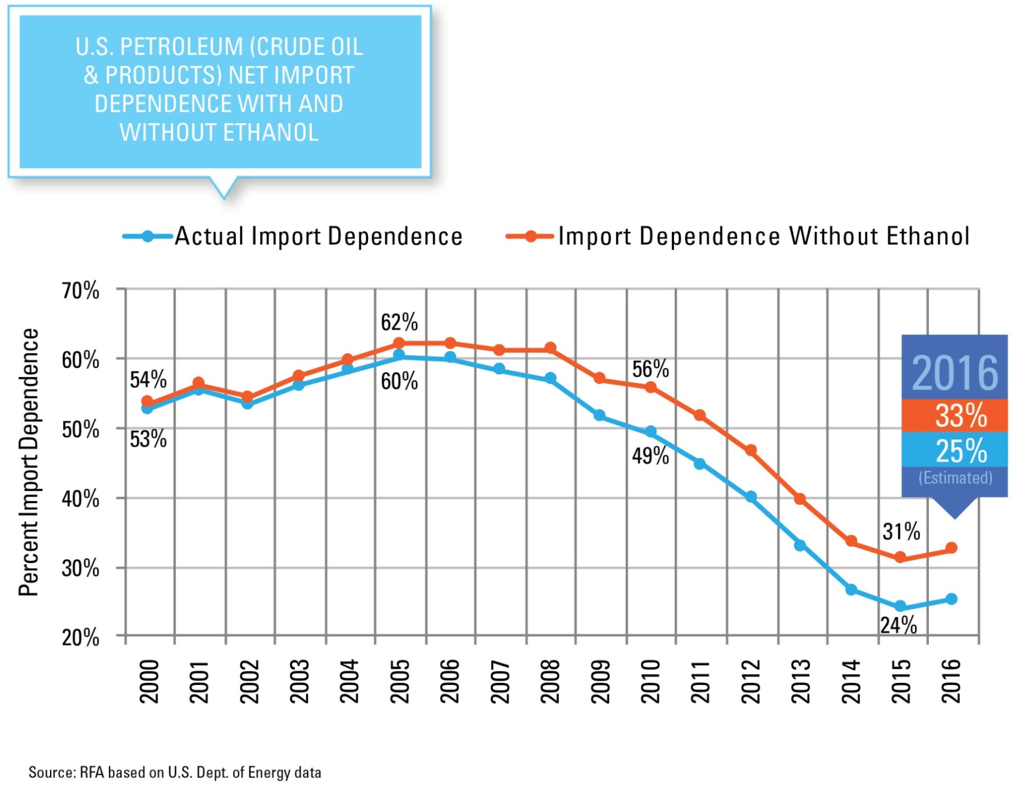

Slide 30
U.S. cropland continues to shrink
U.S. cropland has fallen by nearly 100 million acres (20%) since 1969.
Cropland continued to shrink after the RFS1 was adopted in 2005 and fell further following adoption of RFS2 in 2007.
EPA tracks cropland acreage annually to ensure RFS program is not stimulating cropland expansion beyond 2007 levels.
RFS1 adopted
RFS2 adopted
Sources:
1969-2012 from USDA Agriculture Census; 2013-2016 from USEPA
Includes harvested cropland, cropland pasture, idle cropland, fallow cropland, and failed/abandoned cropland

Slide 31
Productivity gains ensure corn supply is sufficient to meet all demands
2017 crop projected at 14.18 billion bushels on 83.5 million harvested acres.
Producing the same-sized crop with 1980-era technology would have required 156 million harvested acres
 | 1980 | 2017 | Change
Corn Acres Planted (million) | 84 | 91 | +8%
Total Cropland (million) | 470 | 380 | -19%
Yield (bu./acre) | 91.0 | 169.9 | +87%
Production (billion bu.) | 6.6 | 14.2 | 115%
Source: USDA

Slide 32
Corn use for animal feed continues to grow…leading to increased meat supplies
Drought
Source: USDA

Slide 33
U.S. consumer food prices rising more slowly since adoption of the RFS
Source: Dept. of Labor; Bureau of Labor Statistics
RFS1
RFS2

